Slide 1
DOUBLE IDENTITY FINGERPRINT DETECTION

Slide 2

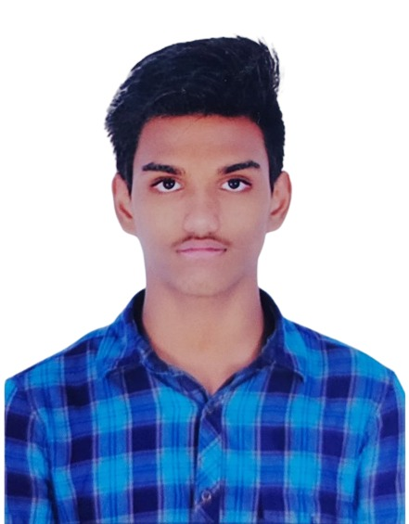

TEAM SPARTANS
Ganesh Kumbhar
Rahul K (LEADER)
Vaibhav Mahant
BTech CSE –
IIITDM Kancheepuram
Pre-Final Year
Expertise in Building
ML/DL models and their
Deployment
BTech CSE –
IIITDM Kancheepuram
Pre-Final Year
Expertise in ML/DL and
Parallel Programming
BTech CSE –
IIITDM Kancheepuram
Pre-Final Year
Expertise in Image
Processing and GUI design

Slide 3
AIM
Abstract
Detection of Double Identity Fingerprints to maintain the integrity of Fingerprint –based biometric security systems and avoid unauthorized access.
Details
Fingerprints are often used as biometric identifiers at border security, financial transactions etc in authentication.
Users consider fingerprint based security systems as Trust-worthy but due to Vulnerabilities like double fingerprints ,they may lose confidence in technology.
Detection of these vulnerabilities can prevent such fraudulent actions and ensure responsibility of individuals.

Slide 4
TOPIC : CLASSIFICATION
We as a group are exploring the field of Biometrics and use of Artificial Intelligence to make Fingerprint based security systems more robust and trustworthy.
We Found out there is a high chance(90%) of bypassing the Fingerprint security systems by this method and no reliable architecture is built till date to detect these attacks.
This Problem is a recent discovery(2017) in the area of biometrics with not much research done which we found challenging.

Slide 5
PROBLEM STATEMENT
Automatic human recognition using universal fingerprint sensors is mostly used modality in modern biometrics based security systems.
The double identity fingerprint is a fake fingerprint created by aligning two fingerprints for max ridge similarity and then joining them along an estimated cutline such that relevant features of both fingerprints are present on either sides of the cutline.
To ensure security of an organization/system, need to identify such imposter fingerprint which is threat to respected system

Slide 6

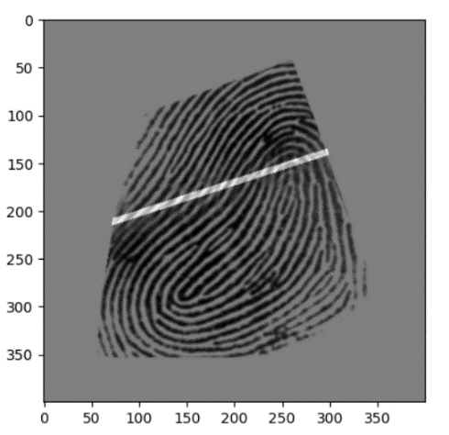

Person 1-Legit user
as in Database
Double identity fingerprint generated using Both Fingerprints sliced and joined along the Boundary.
Person 2-Criminal user As per Database

Slide 7
EXAMPLE SCENARIO
John, a criminal, and his accomplice, Sarah, want to cross a border using fraudulent means. John has a criminal record and wants to evade detection, while Sarah has a clean record and agrees to help John cross the border. They came up with a plan to execute a fingerprint attack.
Creating the Double-Identity Fingerprint:
John and Sarah obtain fingerprints from both individuals. John's fingerprints are of interest to evade detection, while Sarah's are used to create a double-identity fingerprint. They combine selected features from both fingerprints to create a new fingerprint that contains characteristics of both individuals. This new fingerprint will be referred to as the "double-identity fingerprint."

Slide 8
Enrolling the Double-Identity Fingerprint:
Sarah, using a synthesized fake fingertip, enrolls the double-identity fingerprint into government records or an electronic machine-readable travel document (e-MRTD). This process involves submitting the fingerprint data under the guise of Sarah's identity, effectively associating the double-identity fingerprint with Sarah's record.
Crossing the Border:
John presents the e-MRTD containing the double-identity fingerprint at the border gate, impersonating Sarah. The border security system verifies the fingerprint against the enrolled data associated with Sarah's identity. Since the double-identity fingerprint contains features from both John and Sarah, it matches the enrolled data, allowing John to cross the border without raising any suspicions.

Slide 9
WHY EXISTING ALGORITHM FAILS IN CASE OF DOUBLE IDENTITY FINGERPRINT ?
FOR FINGERPRINT MATCHING WE HAVE THE FOLLOWING APPROCHES
Correlation-based approaches directly compare grayscale images using correlation measures.
DRAWBACK : nonlinear distortion can render this comparison unreliable, and it's computationally expensive. (Not very popular).
Minutiae-based approaches are popular, where fingerprints are modeled as sets of minutiae points represented by spatial coordinates and angles. Alignment and matching of corresponding minutiae are performed, often with tolerance for noise and distortion.
DRAWBACK: extraction of minutiae can be unreliable, especially in low-quality images.
Ridge feature-based approaches utilize texture information from fingerprint patterns, providing additional discriminative information but are less discriminative than minutiae and more reliable under low-quality conditions.

Slide 10
Despite these approaches, fingerprint recognition systems still face challenges due to poor image quality, resulting in spurious or missed features, thus degrading system performance.
Due to this challenges we usually set threshold to a low value (nearly 20%).
High threshold will lead to false rejection, so choosing an optimal threshold is challenging and necessary and can be obtained by fine tuning our matching algorithm.
Setting a threshold between 20%-30% will ensure that the correct person is not misclassified because fingerprint features are unique for all and chance of similar fingerprints of two person is nearly 0.
This Low threshold set by us will lead to vulnerability of double identity attack as it can easily bypass the system with a success rate of 90%.

Slide 11
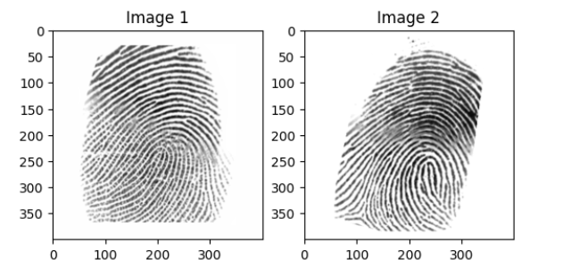
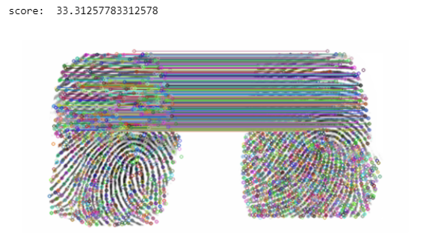
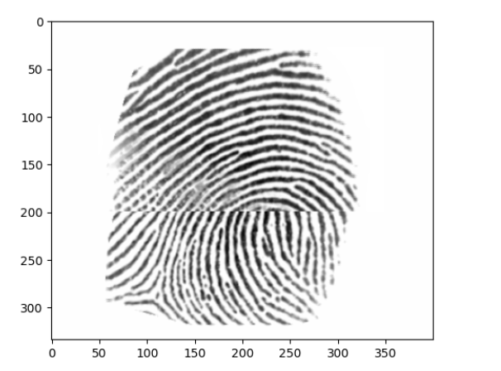
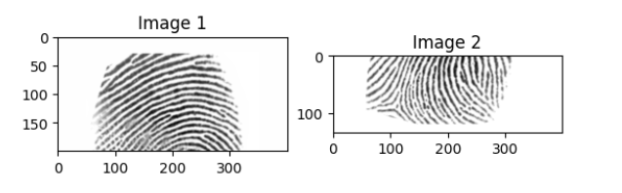
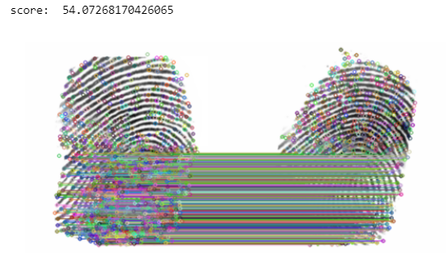
Matching Fingerprint with person 1
Slicing of Fingerprints
In both cases the scores are 33 and 54 for double identity finger print when matched with person 1 and 2 respectively which are more than the Threshold, leading to False acceptance.
Combining sliced images and
alignment of the ridges
Upper slice of Image 1 Lower slice of Image 2
Double Identity Fingerprint
SAMPLE CASE OF FALSE ACCEPTANCE
Matching Fingerprint with person 2

Slide 12
SOLUTION
This Proposed Solution consists of Two – stage Detection of Double identity Fingerprint.
First – at the time of Enrolment.
Second - at the time of Verification(After matching).
Detection of DIF at the time of enrolment :
We are using a classification algorithm to distinguish between Double identity fingerprints and bona fide fingerprints.
Identifying the morphed fingerprint and rejecting them from Registering.
Fingerprints which are classified as genuine are enrolled and their details(fingerprint, verification id) get stored in the database.

Slide 13
At the Time of verification :
Person who is trying to gain access over the system provides his fingerprint for authentication.
We use a matching Algorithm to Find a match from our database and deny the access if no match found and notify to the responsible authority(person in charge).
In case of match, we are adding a second stage of security here to detect if the registered fingerprint is a Double identity Fingerprint.
At the time of enrolment, there might be some misclassifications by our model, as it can’t promise 100% accuracy, which might result in False acceptances.
Hence, to detect these misclassifications, we are adding another layer of security at the time of matching.
In this, we use a different algorithm to detect the double identity fingerprints and estimate the optimal cutline if a DIF is found.
Need for Detection of DIF After matching :

Slide 14
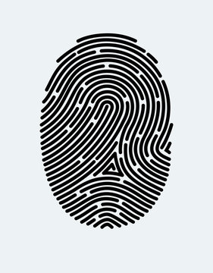
Yes
DIF Detected, Enrolment denied
ENROLMENT
DIF Detection Algorithm -1
No
Enrolment Granted
New User
PROCESS FLOWCHART
FOR DIF DETECTION
MODEL
Register to Database
Database
user_id -
User id
User Id not found
VERIFICATION
User Id found
Score less than threshold
Fingerprint Matching Algorithm
Access Denied as not authorized user
Score greater than threshold
Verifying User
DIF Detection Algorithm - 2
No
Access Granted
Yes
DIF Detected
Access Denied

Slide 15
TECHNOLOGIES :
Double identity Fingerprint Algorithm 1 at the time of registering a new user.
Image preprocessing to enhance quality and extract relevant features using opencv.
Blurring - high-frequency noise components are attenuated, resulting in a cleaner image.
Normalization – Remove noise due to sensor and pressure differences.
Gabor Filter Process – Ridge detection.
Thinning – reducing the width of the ridges.
Random Forest Classifier – An ensemble technique used in classification, produces robust results to classify Between Single and Double Fingerprints.
Trained on the Dataset containing a mix of both double and single identity Fingerprints from Double_fp_dataset and Single_fp_dataset.

Slide 16
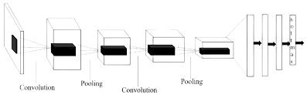
Matching Algorithm
Preprocessing of fingerprint obtained from the user and Database(via user id).
Minutiae Based Matching algorithm
SIFT – Feature Extraction
KNN – To match the features.
Threshold Based Acceptance
Double identity Fingerprint Algorithm 2
Deep Convolutional Neural Network to add another layer of security to overcome False Acceptance which bypassed Algorithm 1.
Classification and Optimal Cut-line estimation(axis along which Fingerprints are joined).

Slide 17
Libraries :
Open-cv, Numpy, Pandas, OS, TensorFlow, Matplotlib, Scikit-learn, joblib
Algorithm Architecture
Algorithm 1 – Random Forest with 100 estimators(decision Tree).
Feature extraction algorithm – SIFT (500 Features(key points)) .
Algorithm 2 – CNN with Multiple convolution and pooling layers and a Fully connected layer with softmax as Activation Function used at output Layer.
References:
Deep Convolutional Neural Network for Double-Identity Fingerprint Detection Ishank Goel, Niladri B. Puhan and Bappaditya Mandal.
Detecting Double-Identity Fingerprint Attacks M. Ferrara, R. Cappelli and D.Maltoni, Senior Member, IEEE.
Future Aspects – Willing to continue the research in this area and Publish a research paper.

